Slide 1



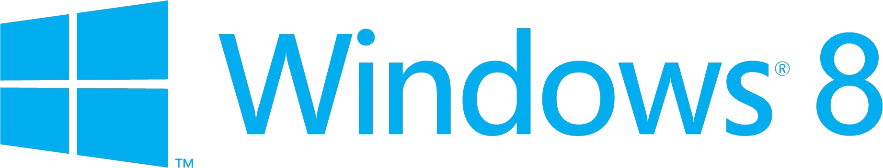
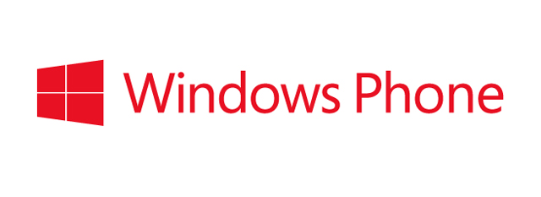
Windows Phone 8 Developer Lap Around
Nick Randolph
nick@pixelandsons.com
@btroam

Slide 2
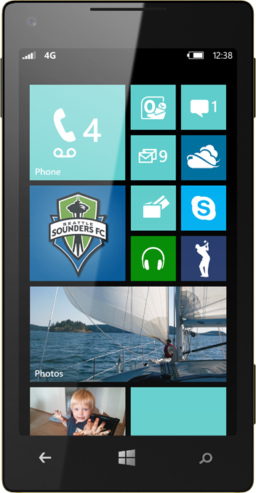
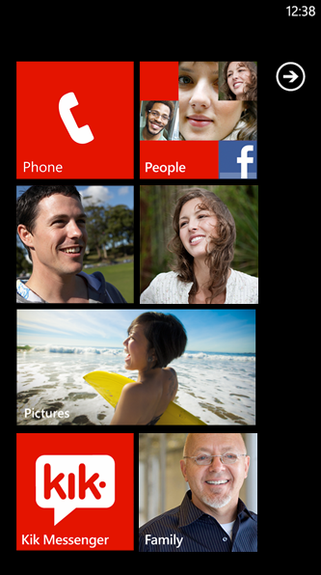
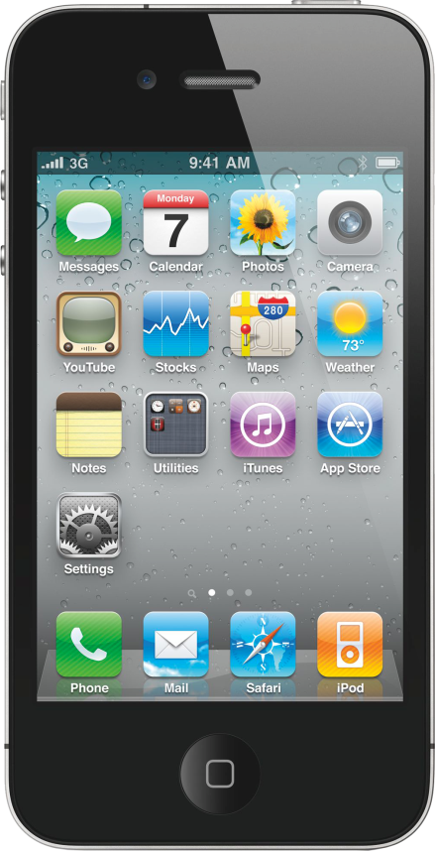
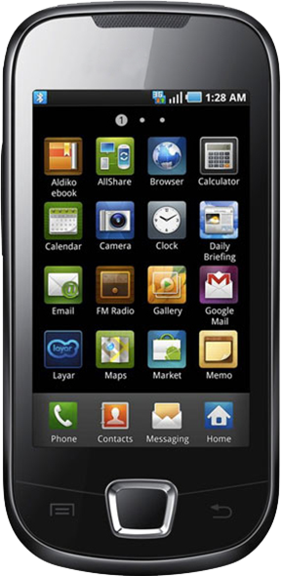
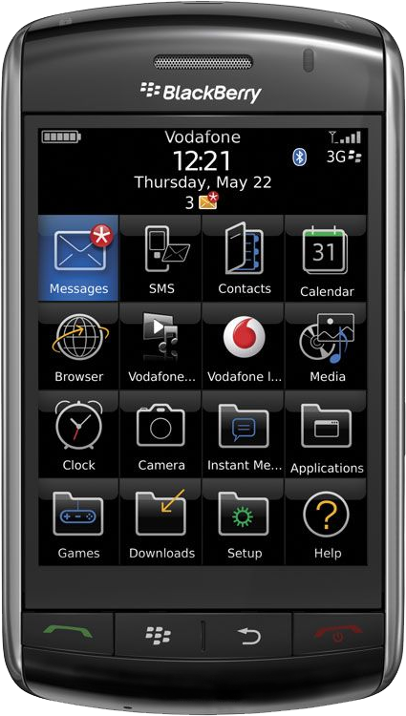
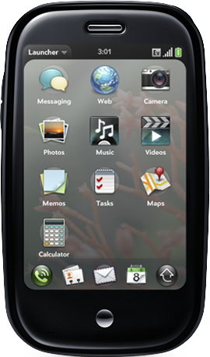
vs.
People
Icons
Notes:
Looking across every other mobile platform, we see the same thing, buttons, buttons, buttons. From the beginning, Windows Phone has offer the alternative: The people we care about. The pictures we’ve taken. Tiles exist to bring us closer to the content we care about.

Slide 3
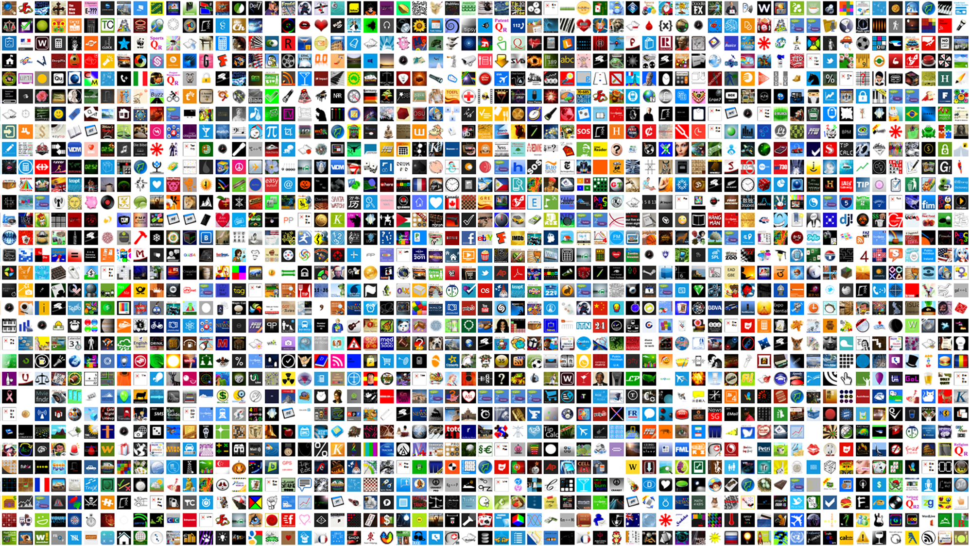



























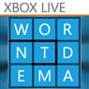









130,000 Windows Phone Apps
Notes:
And we’ve seen developers embrace that. In only 2 years, we’ve grown to over 120,000 Windows Phone apps with the numbers constantly climbing and exciting new apps entering the Windows Phone Store every day.

Slide 4

8 Things Developers Must Know About Windows Phone 8
Notes:
With that, let’s talk specifics. I could talk all day about the great features of Windows Phone 8, but for now let’s trim that back to just 8 things we as developers must know about Windows Phone 8

Slide 5
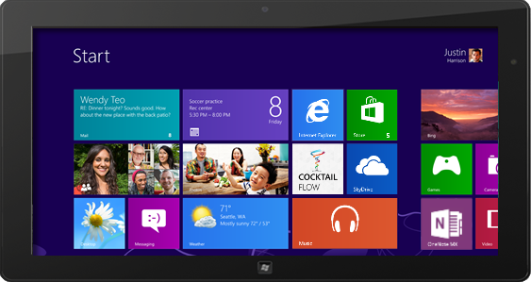
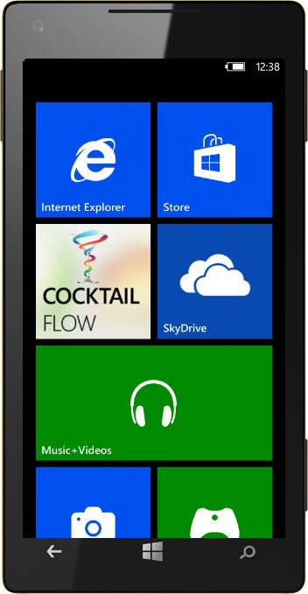
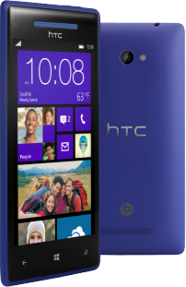
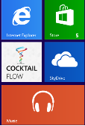
Shared WinRT Core
1

Slide 6
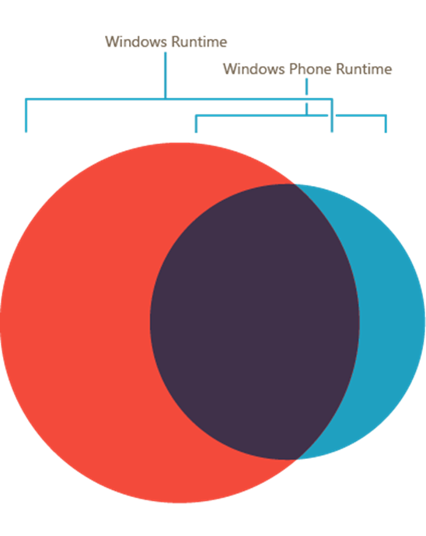
Shared WinRT Core
1

Slide 7
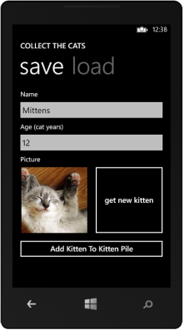
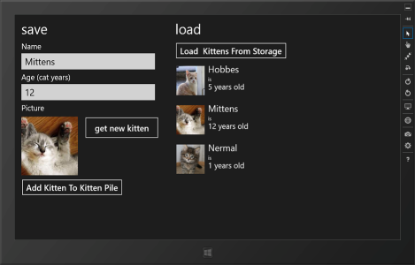
Shared WinRT Core
1
Demo
Storage API
Notes:
The shared WinRT core means that when we’ve written our Windows Phone app, we’re well on our way to writing our Windows 8 app as well. In this example, we have the same application doing the same thing and using the same underlying code. We can save elements to our phone or tablet storage, recall those items, edit them. The differences in this demo are related entirely to the design considerations inherent in developing for different screen sizes.

Slide 8
Windows Phone 8 Programming APIs
Windows Phone 8 supports
Managed app dev using the WP7.1, WP8.0 .NET and Windows Phone Runtime APIs
Native app dev using Windows Runtime and Win32
Games dev using the WP7.1 XNA framework
Games dev using Direct3D or DirectX
WP8.0 Games DirectX/Direct 3D & C++
WP8.0 XAML & C#/VB with Direct3D Graphics
+ C++
WP8.0 XAML & C#/VB
+ C++
WP7.1 XNA & C#/VB
WP7.1 XAML & C#/VB
.NET API for Windows Phone
Windows Runtime
Win32 & COM
Managed
Managed & Native
Native

Slide 9

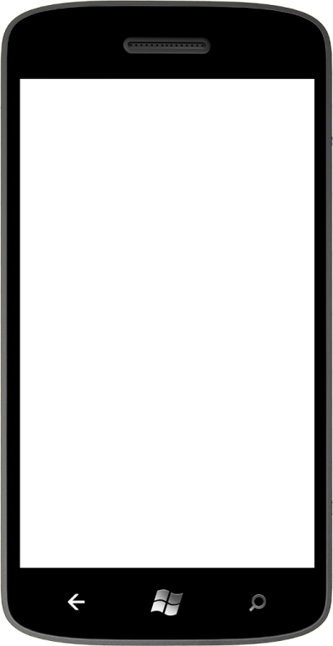
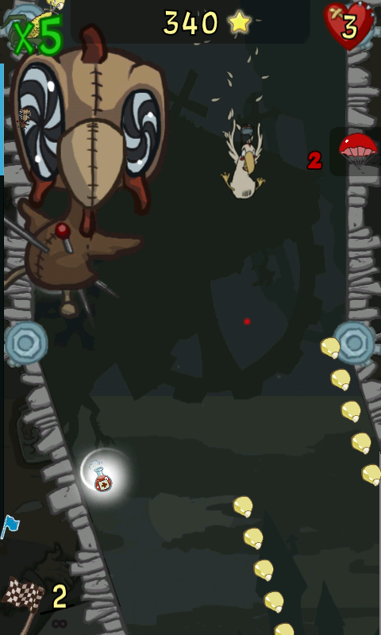

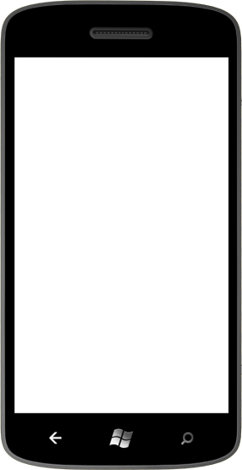

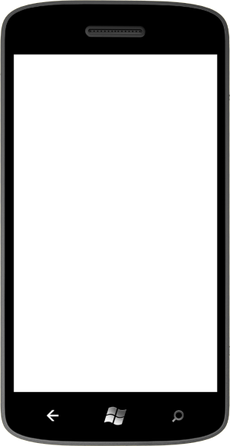
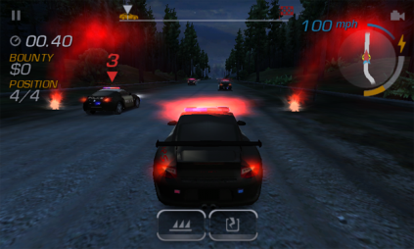
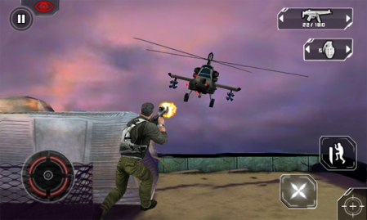
Native Code for Killer Games
2
Native game development platform based on DirectX
Developers can write the same game for Windows 8 and Windows Phone
Notes:
In the gaming arena, Microsoft now supports a common game development platform across Windows and Windows Phone. This gives developers the ability to develop games natively with access to the hardware acceleration benefits of DirectX and Direct3D.

Slide 10





Native Code for Killer Games
2
Notes:
This also means that Windows Phone games can take advantage of middleware gaming engines, animation and physics libraries, audio engines. The promise in this arena can be seen as we already have partners such as havoc, audiokinetic, fmod and Autodesk developing middleware products to aid developers in creating the highest quality games in the mobile market.

Slide 11

Native Code for Killer Games
2

Slide 12
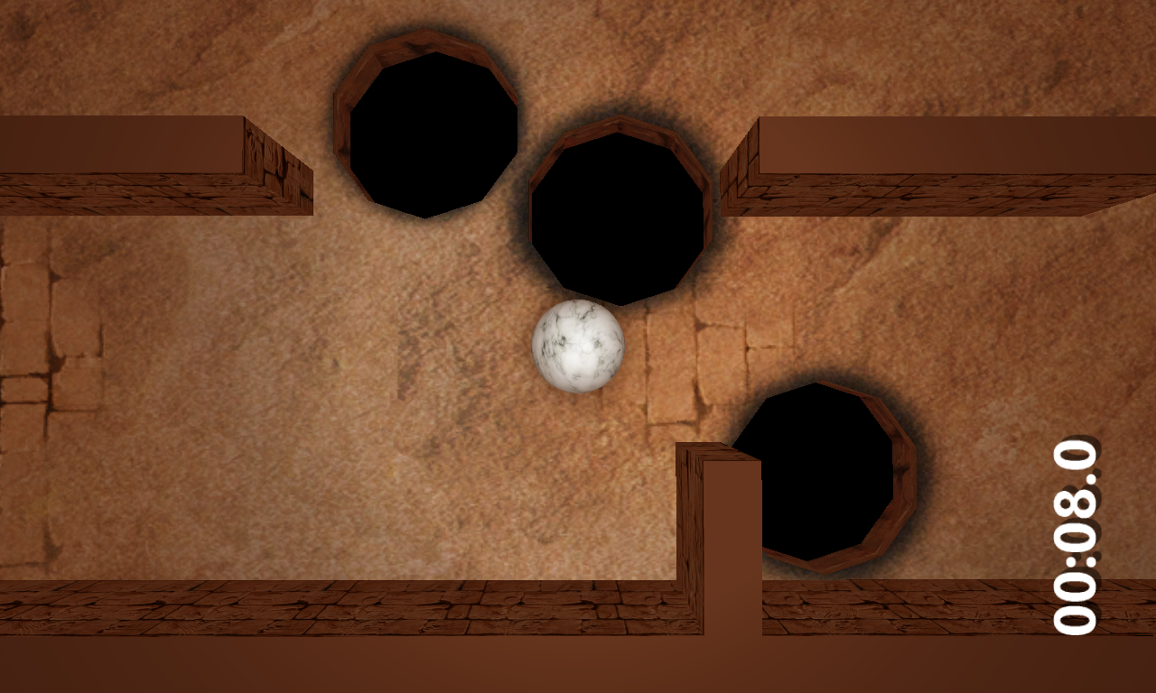
Native Code for Killer Games
2
Marble Maze

Slide 13
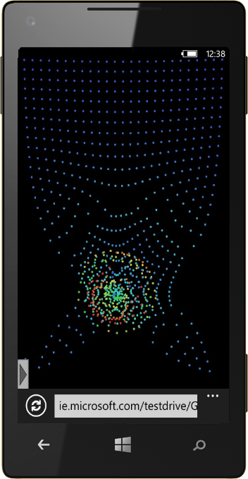
Internet Explorer 10
3
4x faster JavaScript performance
2x HTML5 feature support
In-Browser Multi-Touch Capabilities
Notes:
Number 2, we’ve upgraded the browser in Windows Phone 8 to Internet Explorer 10. When compared to IE 9 in Windows Phone 7.5, IE10 for Windows Phone 8 has 4 times faster Javascript performance and supports 2 times as many HTML 5 features. It also carries with it such IE 10 features as SmartScreen anti-phishing filter which uses data from millions of Windows PCs to block malicious websites in real time.
And this experience transfers over to your application development. The WebBrowser that you use in your app is simply an instance of the same IE10 browser on the phone, bringing with it all the same functionalities and benefits including the industry standardized multi-touch support.
The image you see here is an interactive gravity particle animation driven by multi-touch functionality and running on Windows Phone 8.

Slide 14
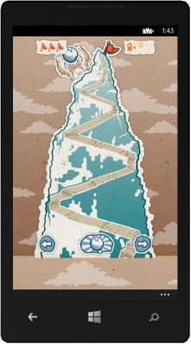
Internet Explorer 10
3
Demo
Yeti Bowl
Notes:
Number 2, we’ve upgraded the browser in Windows Phone 8 to Internet Explorer 10. When compared to IE 9 in Windows Phone 7.5, IE10 for Windows Phone 8 has 4 times faster Javascript performance and supports 2 times as many HTML 5 features. It also carries with it such IE 10 features as SmartScreen anti-phishing filter which uses data from millions of Windows PCs to block malicious websites in real time.
And this experience transfers over to your application development. The WebBrowser that you use in your app is simply an instance of the same IE10 browser on the phone, bringing with it all the same functionalities and benefits including the industry standardized multi-touch support.
The image you see here is an interactive gravity particle animation driven by multi-touch functionality and running on Windows Phone 8.

Slide 15
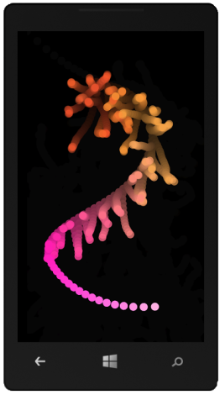
Internet Explorer 10
3
JS Library Example
ProcessingJS on Windows Phone
Notes:
Number 2, we’ve upgraded the browser in Windows Phone 8 to Internet Explorer 10. When compared to IE 9 in Windows Phone 7.5, IE10 for Windows Phone 8 has 4 times faster Javascript performance and supports 2 times as many HTML 5 features. It also carries with it such IE 10 features as SmartScreen anti-phishing filter which uses data from millions of Windows PCs to block malicious websites in real time.
And this experience transfers over to your application development. The WebBrowser that you use in your app is simply an instance of the same IE10 browser on the phone, bringing with it all the same functionalities and benefits including the industry standardized multi-touch support.
The image you see here is an interactive gravity particle animation driven by multi-touch functionality and running on Windows Phone 8.

Slide 16
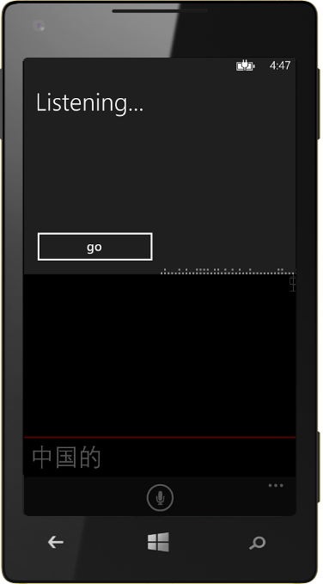
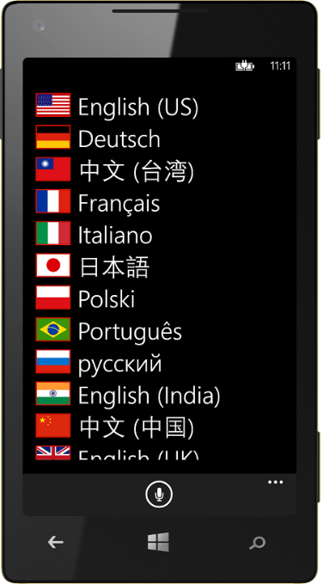
Speech
4
Integrate speech-to-text and text- to-speech with Speech APIs
15 supported languages
Voice commands to open apps from start screen
Notes:
Speech is another exciting addition to Windows Phone with this release. The new Speech APIs allows very simple Speech to text, allowing the user to speak directly to apps, and text to speech, allowing many eyes-free operations as well as expanding accessibility options.
Windows Phone 8 supports 15 languages and dialects and many more options for speaking voices and the speech APIs also allow developers to open their apps to specific points (or with custom input) using voice commands.

Slide 17

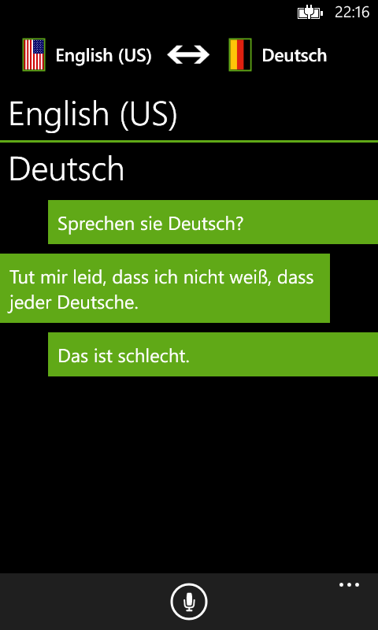
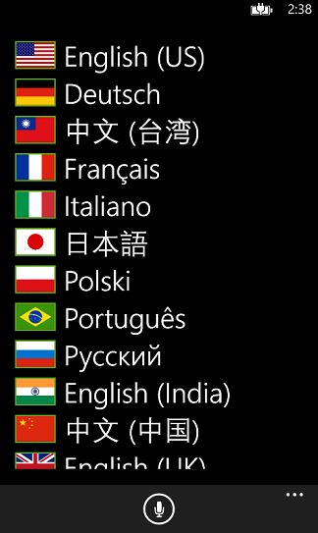
Speech
4
Notes:
Speak Easy is a demo I wrote to demonstrate the speech capabilities of Windows Phone integrated with the translation capabilities of Windows Azure Translation Service. The user can speak

Slide 18
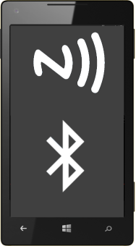
Proximity APIs
5
NFC
Tap-to-Share
NFC Tags
Device-to-Device
Bluetooth APIs

Slide 19
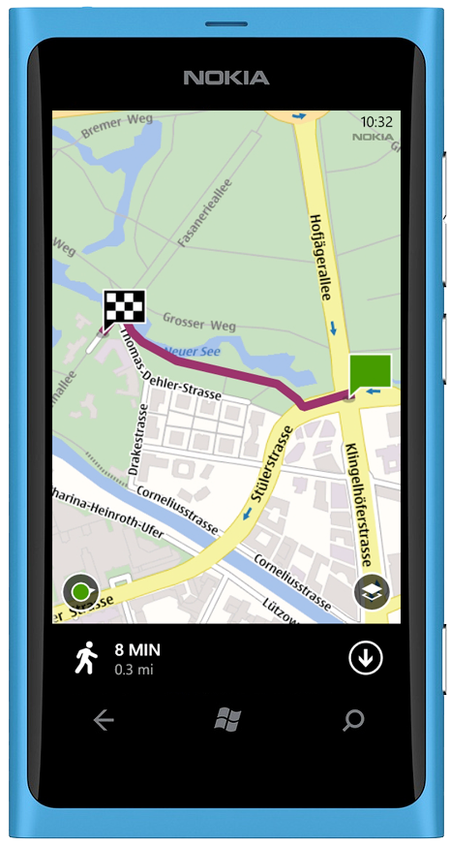
Nokia Map Technology
6
Excellent global NAVTEQ map data
Download map data for offline use
Turn-by-turn directions
Background location tracking
Notes:
The Windows Phone maps have also gone through a major change, shifting to Nokia’s NAVTEQ map data. This provides us with maps based on roads, aerial information, a hybrid or terrain-based maps. Users no longer need to register for the Bing Maps control to use map functionality in their apps, the new map control gives them full mapping capabilities.
Additionally, apps can now easily download map data for offline use and update that data as needed. And if they need to continuously track location (for example in exercise applications), Windows Phone has the ability to continue collecting location data either periodically or in the background.

Slide 20
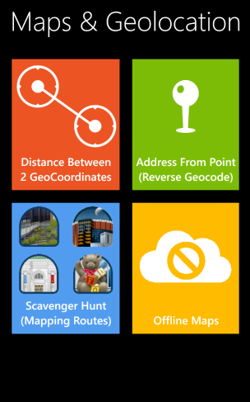
Nokia Map Technology
6
Demo
Mapping Services

Slide 21
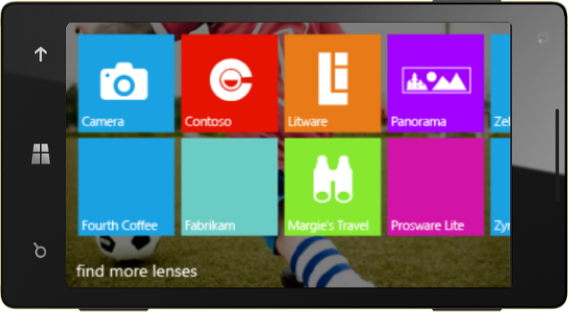
Pictures and Lenses
7
Lens apps integrate into the camera
Auto-upload pictures to web service
Notes:
One of the greatest Windows Phone features is how developers can add value even to the native applications. For example, we have a feature called lenses. Let’s say the user wants to take a picture, but wants to add some kind of special filter or mode, wants to take a panorama or go into an augmented reality mode. Right from the native camera application, they can see all the lens applications that extend the possibilities of the camera and bring even more user visibility to their app.
We also have the ability for users to auto-upload all the pictures they take to a web service. This means we can write an app that allows the user to automatically save all their images to 500px or Flickr or yfrog or our own web service. This is a great way to jump-start content sharing in a new fresh application.

Slide 22
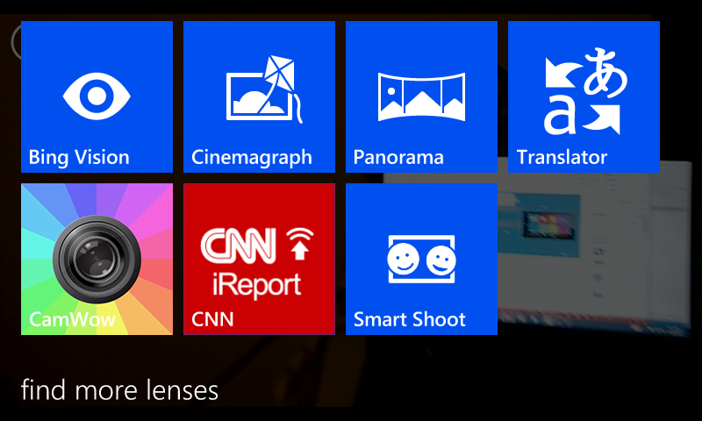

Pictures and Lenses
7

Slide 23
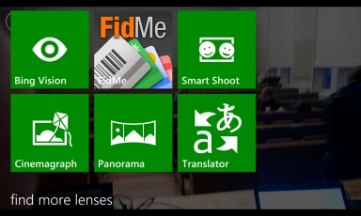
Pictures and Lenses
7
Demo:
Cinemagraph

Slide 24
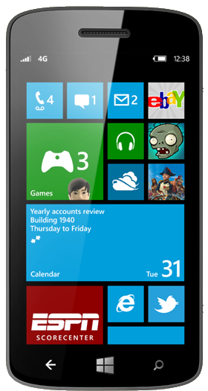
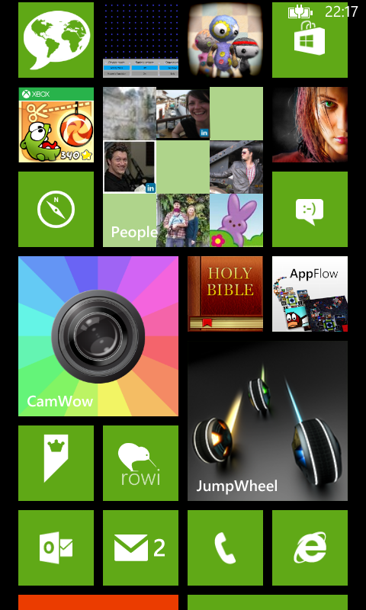
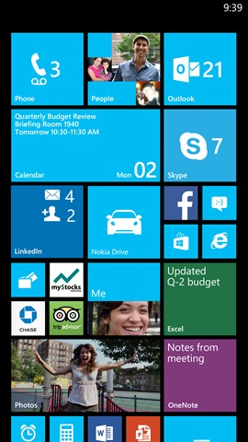
The
My
Start Screen
8
Notes:
And finally, we come back to the heart and soul of the Windows Phone, the start screen. The start screen has always been the key component to Windows Phone, giving each phone a unique personality, bringing custom content and information straight to the user.
In fact, I don’t like to talk about The start screen. I prefer to talk about my start screen. What is important to me. My pictures, my games, my demos, my people hub at the center top of my screen. My communication lining the bottom of the screen. Social apps together, and AppFlow for finding even more great apps for my phone.
And for developers we’ve added new capabilities for bringing your apps to users so they can use them. We have 3 kinds of tile sizes for the start screen, so the user can prioritize their screen around what is important to them. Developers have the option of using 3 kinds of tiles so that they can add the start screen experience that makes the most sense for their app. The entire development experience helps you bring the best app experience of any platform to your users.
(Optional: Mention flip tiles (image on front, text on back), Iconic Tiles (counts up on new notifications like the native SMS, email and phone call apps) and Cyclic tiles (cycles through images like the photo app))

Slide 25



3 Tile Types
8
Iconic
Flip
Cycle

Slide 26
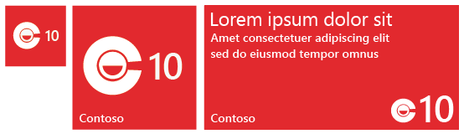
3 Tile Sizes
8
Small
Wide
Medium

Slide 27
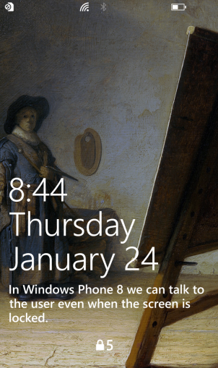
Lock Screen Access
8
Lock Screen Backgrounds
Lock Screen Text
Lock Screen Notifications

Slide 28
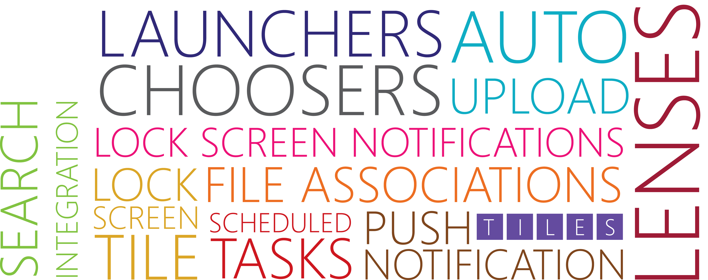
More than an app
Notes:
Windows Phone apps are more than just an app. Windows Phone gives you the opportunity to break out of the sandbox. You can reach the users through 3 kinds of live tiles bringing information and content to the user straight on their home screen. Or, if you think that getting to the home screen, your app can create lock screen notifications so your information is front-and-center for the user at all times. You can schedule tasks to update even when your application isn’t in the foreground, you can integrate into Bing search, you can integrate into the camera through the Lenses features… there are a dozen ways to bring your users more interaction and more functionality by truly integrating into Windows Phone functionality.

Slide 29
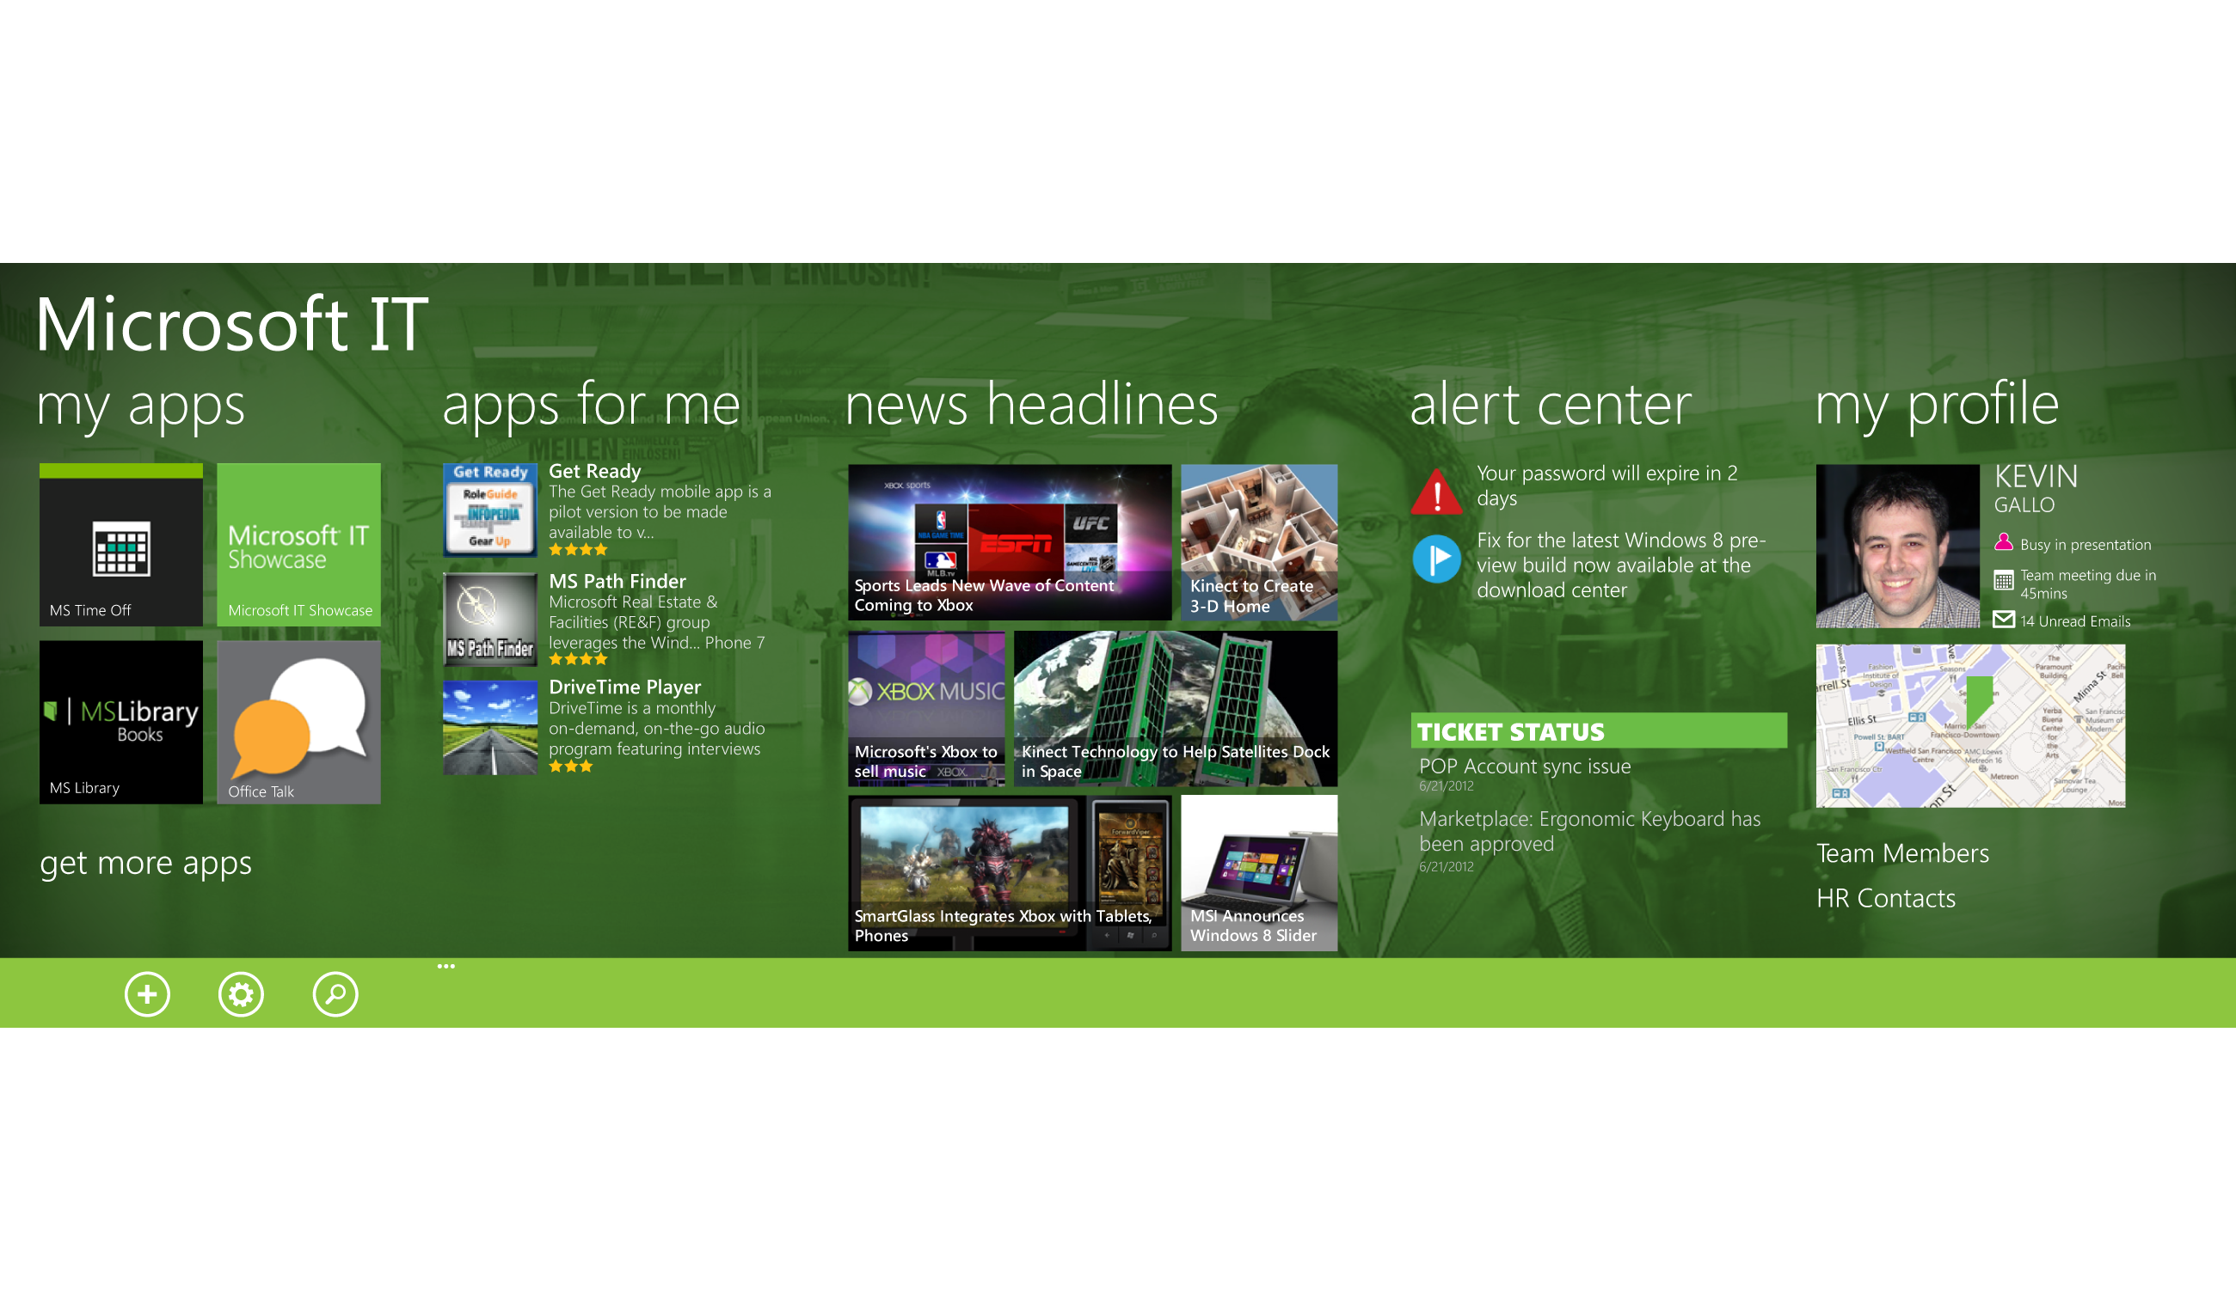
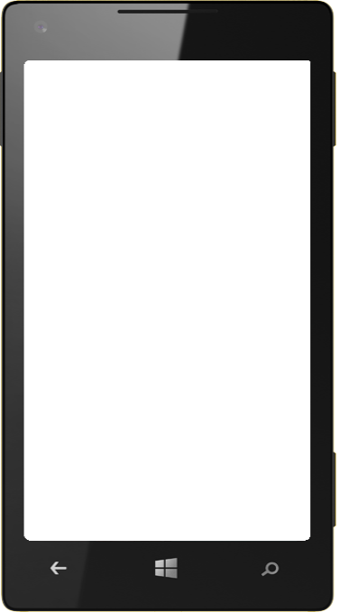
Company hub
Notes:
For our enterprise customers, Windows phone provides the ability to create entire suites of secure enterprise specific applications and make them accessible only within the enterprise using the company hub.

Slide 30
Windows Phone 8
1
Shared Core
2
Internet Explorer 10
3
Native Code (Games)
4
Speech APIs
5
NFC & Bluetooth
6
Nokia Mapping
7
Lenses
8
Tiles & Notifications

Slide 31
Windows Phone 8 developer resources
MSDN DOCS
Design | http://aka.ms/wp8devdesign
Develop | http://aka.ms/wp8devdoc
Test | http://aka.ms/wp8testing
Publish | http://aka.ms/wp8publishing
Samples | http://aka.ms/wp8samples
NEWS & UPDATES
Portal | http://dev.windowsphone.com
Blog | http://wpdev.ms/developerblog
Channel 9 | http://wpdev.ms/insidewp
Twitter | http:/twitter.com/wpdev
TRAINING CONTENT
Absolute Beginners | http://wpdev.ms/beginvids
Jump Start | http://aka.ms/wp8js
Design Boot Camp | http://aka.ms/wp8designbootcamp
Training Kit | http://aka.ms/wp8hol

